Slide 1
CS 2200
LAB 8

Slide 2
Announcements
Exam 2 was today 💯💯
HW6 (virtual mem) is out tonight and due March 13th
Project 3 is out and due March 15th

Slide 3
Today’s Topics:
Virtual Memory & Paging

Slide 4
Paging
As memory grows larger, external fragmentation becomes a huge problem
The solution = virtual memory
Paging is an implementation of virtual memory
Divide user programs into logical entities called pages
Divide physical memory into entities called page frames
Page size = the size of pages/page frames (e.g. 2^something bits)
used to compute offset
A page frame in physical memory houses a page from a user program

Slide 5

Paging Analogy
You are a professor who wants to get familiar with students, so you print pictures of all of them
You keep three picture frames in your OH room
When a student comes to visit, put their photo in a frame

Slide 6
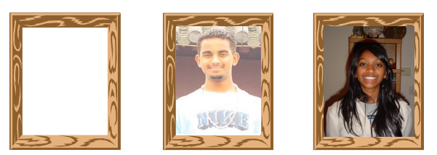
Paging Analogy cont.
2 students come in, so you put their pictures in any of the empty frames
If more than three come in, replace the picture in a frame
Major point → only need 3 frames for virtually infinite number of pages (if you page fault every 5 sec)
Picture frames = page frames
Pictures = pages
Note: you don't need a unique frame for each student! Just swap out pictures so that the frames have the ones you need in a given moment (this is called demand paging!)

Slide 7
Exercise: Paging True/False
The number of pages in virtual memory and number of frames in actual memory are exactly the same.
Physical memory will always have enough space to allocate all of a process’ pages.
VPN bits is same as PFN bits

Slide 8
Solution: Paging True/False
The number of pages in virtual memory and number of frames in actual memory are exactly the same.
False
Physical memory will always have enough space to allocate all of a process’ pages.
False
VPN bits is same as PFN bits
False

Slide 9
Exercise: Address Translation
Our system has:
32-bit virtual addresses
24-bit physical addresses
1KB Page Size
How many bits are used for the offset?

Slide 10
Solution: Address Translation
Our system has:
32-bit virtual addresses
24-bit physical addresses
1KB Page Size
How many bits are used for the offset?
log₂(1024) = 10 Bits
How many bits are used for the virtual page number (VPN)? Physical page number (PFN)?

Slide 11
Solution: Address Translation
Our system has:
32-bit virtual addresses
24-bit physical addresses
1KB Page Size
How many bits are used for the offset?
log₂(1024) = 10 Bits
How many bits are used for the virtual page number (VPN)? Physical page number (PFN)?
32 bits - 10 offset bits = 22 VPN bits 24 - 10 offset bits = 14 PFN bits

Slide 12
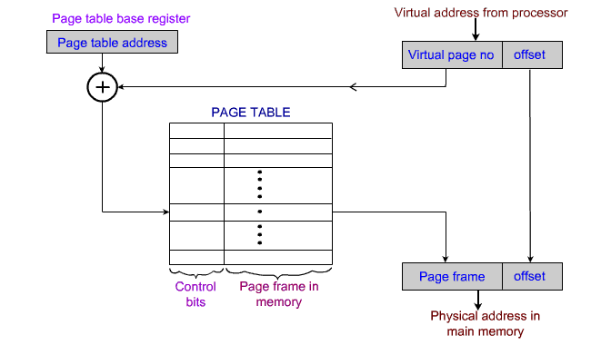
Address Translation

Slide 13
Exercise: How many page table entries?
For a 4GB (2³² byte) virtual address space and a page size of 4KB (2¹² bytes), how many page table entries will there be?

Slide 14
Solution: How many page table entries?
For a 4GB (2³² byte) virtual address space and a page size of 4KB (2¹² bytes), how many page table entries will there be?
32 - 12 = 20 bit VPN
2²⁰ page table entries
For a 2²² physical address space and the same page size, how many physical frames will there be?

Slide 15
Solution: How many page table entries?
For a 4GB (2³² byte) virtual address space and a page size of 4KB (2¹² bytes), how many page table entries will there be?
32 - 12 = 20 bit VPN
2²⁰ page table entries
For a 2²² physical address space and the same page size, how many physical frames will there be?
22 - 12 = 10 bit PFN
2¹⁰ frames = 1024

Slide 16
Page Table
An array of virtual to physical memory mappings for each process.
2^(VPN bits) entries in each page table.
Base address stored in the processors Page Table Base Register, PTBR (cr3).
The page table needs one entry per page.
For a 4GB (2³² byte) virtual and physical address space and a page size of 4KB (2¹² bytes), we see that the 2³² byte address space must be split into 2²⁰ pages, meaning the page table must have 2²⁰ entries.

Slide 17
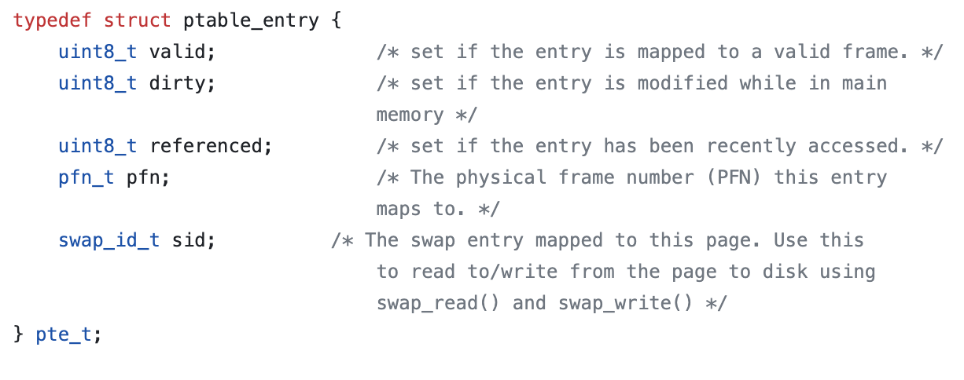
Page Table Entry (PTE)
For every translation of a virtual page to a physical frame, store a PTE in the Page Table.
Store some bits along side the translation in order to tell the operating system the permissions of the page (e.g. valid bit, dirty bit)

Slide 18
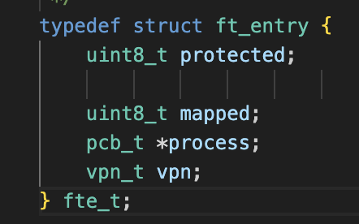
Frame Table
Array mapping PFNs to tuple of PCBs and associated VPNs
May also include miscellaneous bits for if a frame is protected or currently mapped
e.g. of FTE →
Why would a frame be protected?

Slide 19
Exercise: Page Fault
Page Size: 256 B
Virtual Address: 0x0153
What is VPN & Offset?

Slide 20
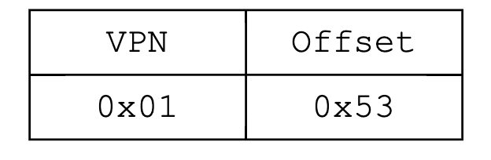
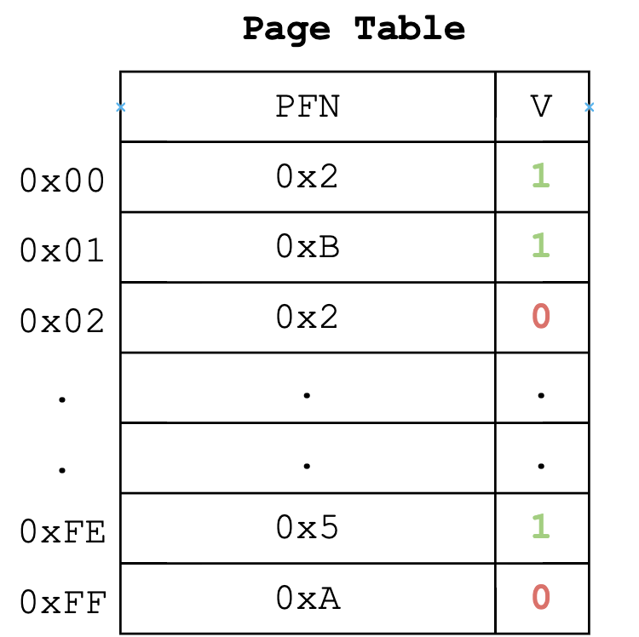
Solution: Page Fault
Page Size: 256 B
Virtual Address: 0x0153
What is VPN & Offset?
VPN: 0x01
Offset: 0x53
Given the page table, what would be our PFN?

Slide 21
Solution: Page Fault
Page Size: 256 B
Virtual Address: 0x0153
Given the page table, what would be our PFN?
0xB
What about for virtual address 0x02C8?

Slide 22
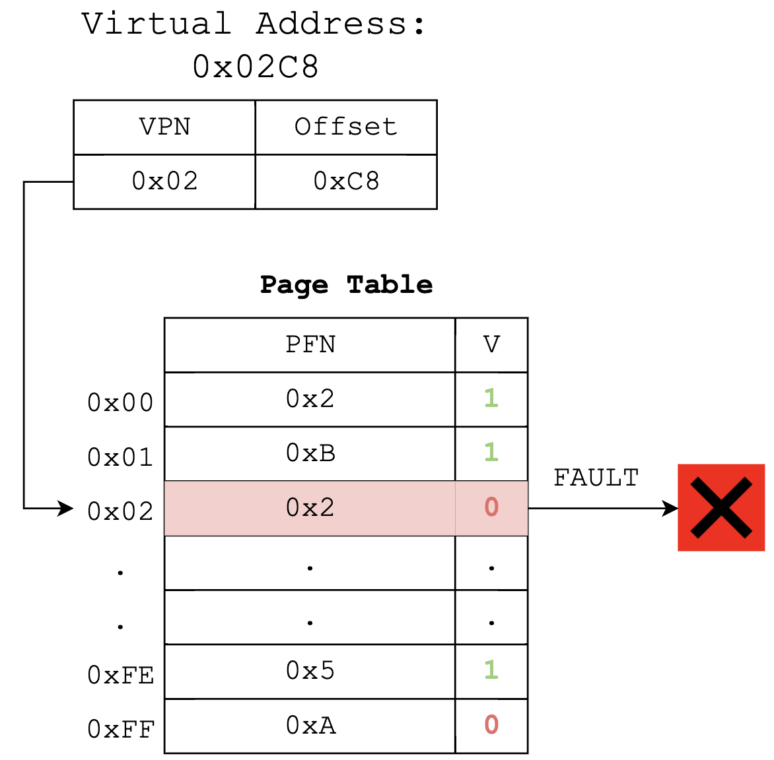
Solution: Page Fault
Page Size: 256 B
Virtual Address: 0x0153
What about for virtual address 0x02C8?
PAGE FAULT!!!! (valid bit 0)

Slide 23
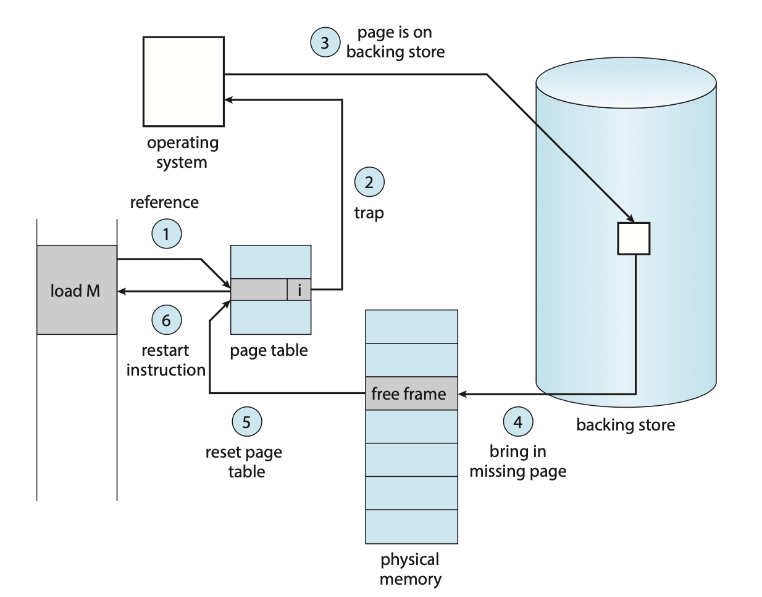
Page Fault
Raise an operating system trap every time you try and access a page that is not valid.
Steps to solve
Find free page using page replacement algorithm
Locate faulting page from disk, swap it in
Update page table entries (now its bit is valid=1, the page which swapped out is invalid=0)

Slide 24
Page Replacement Algorithm
Local victim selection: Choose a victim frame from the processes own pool of memory.
Poor memory utilization.
Global victim selection: Steal a physical frame from any process, not necessarily the faulting one.
Good utilization since we have more choices for victim frames. Needs more metadata to be handled by the OS.
The goal of these algorithms is to decrease the overall number of page faults by evicting frames that are not used or will not be used later on.
Page faulting is super expensive time-wise

Slide 25
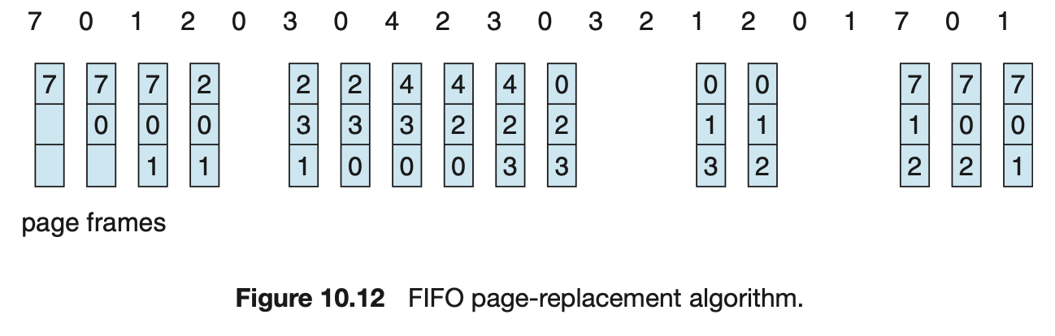
First In First Out (FIFO)
Keep track of when a page was brought into memory.
If a page has to be replaced, choose the longest resident page as the victim.
This can be done though a simple heuristic FIFO by using a circular queue.

Slide 26
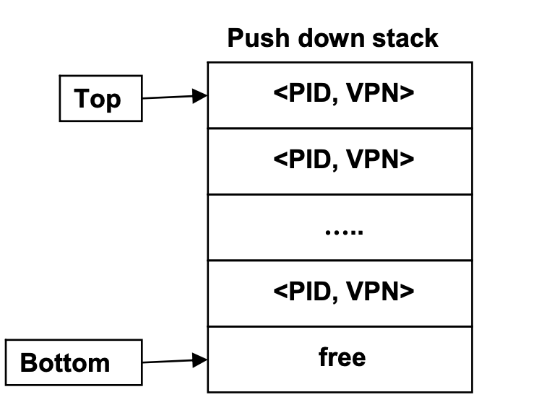
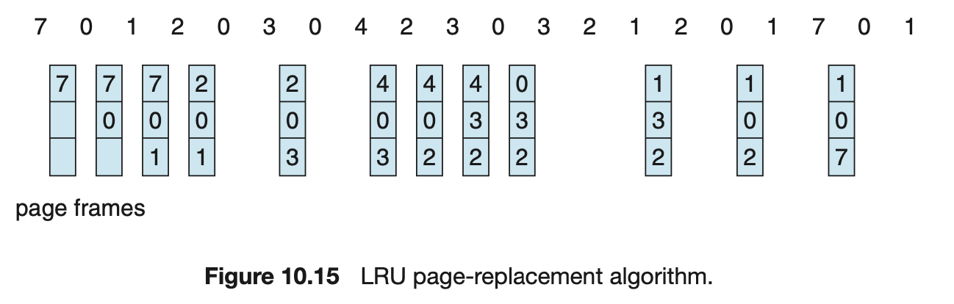
Least Recently Used (LRU)
Replace the page with the least recent read/write.
Keep track of pages in a stack.
When a page is faulted in or used, move it to the top of the stack
Evict the page at the bottom of the stack.
Incurs a very large overhead.
Need to do stack operations on every page use/fault

Slide 27
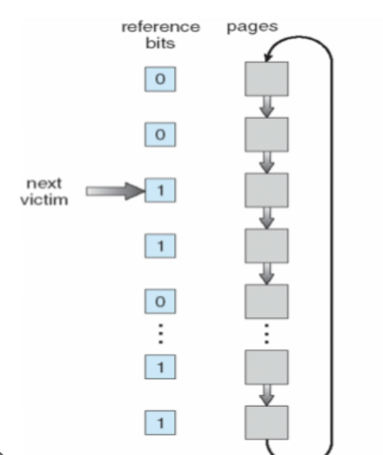
Exercise: Second Chance Replacement
If our “next victim” pointer is pointing to page 3, which page will be the chosen victim using Second Chance Replacement
1
2
3
4
5
15
16

Slide 28
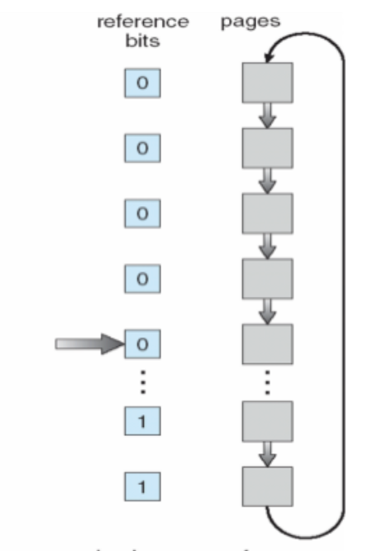
Solution: Second Chance Replacement
If our “next victim” pointer is pointing to page 3, which page will be the chosen victim using Second Chance Replacement
Page 5.
Since page 3 & 4 had their referenced bit set high, they will be set low and the first page with a low referenced bit is page 5
1
2
3
4
5
15
16

Slide 29
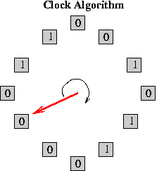
Second Chance Replacement
Reference bits to keep track of when a page was used
The OS will sets reference bits upon reference to the page.
Choose a page using FIFO.
If the chosen victim’s reference bit is set, then clear the reference bit and iterate again through the circular queue.
The victim is the first candidate in FIFO order whose reference bit is not set
If all or no reference bits are set when the algorithm begins, this is equivalent to FIFO selection (why?)

Slide 30
Translation Lookaside Buffer

Slide 31
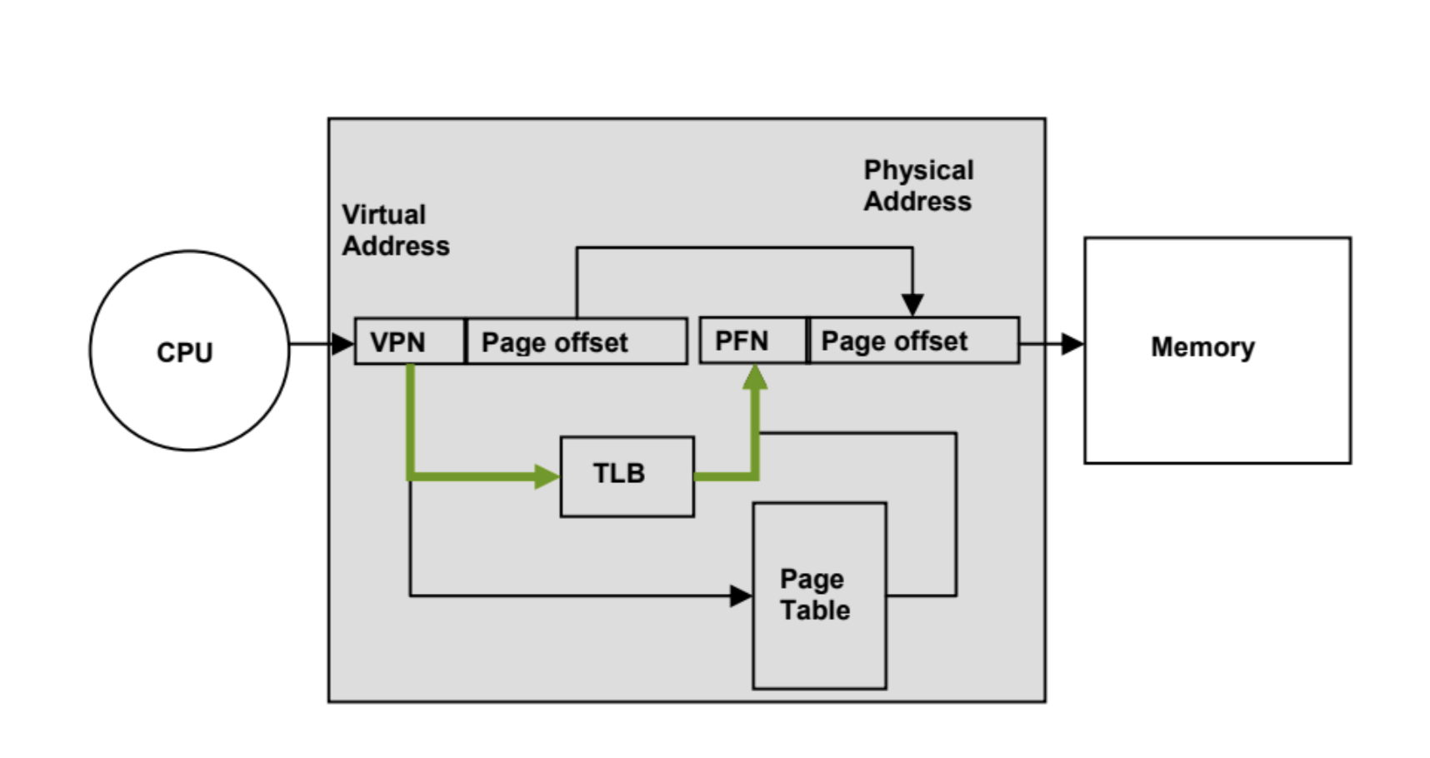
What’s the TLB?
The entire page table can’t fit in registers
Instead, we use a shortcut -- a small table that holds recently accessed mappings.
A cache with recent VPN-PFN mappings
Prevents multiple access to memory for page table translations (if you’re accessing the same address a lot)

Slide 32
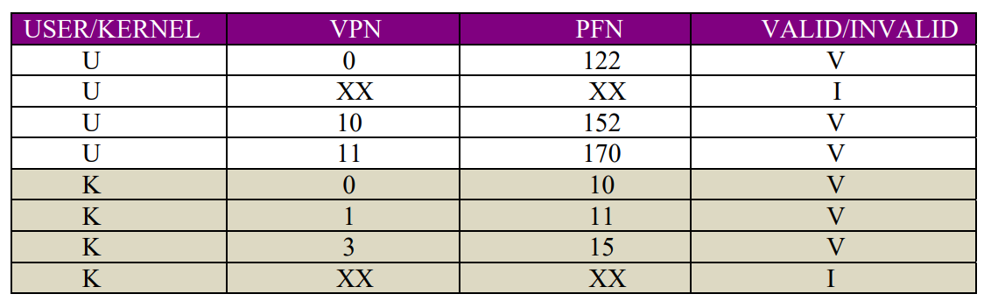
TLB Internals
User entries are specific to each process
Kernel entries are the same for all processes
Q. What must the TLB do on a context switch?
(hint: do we want VPNs now to be valid?)

Slide 33
TLB Internals
User entries are specific to each process
Kernel entries are the same for all processes
Q. What must the TLB do on a context switch?
On a context switch, the OS will invalidate the user address space translations. The kernel translations will however be kept because they are independent of the user processes.

Slide 34
Hits and Misses
HIT: Target memory address exists in cache (no need for memory lookup)
Hit Ratio(h): Ratio of cache accesses that are hits.
MISS: Target memory address doesn’t exist in cache (need to do a memory lookup)
Miss Ratio(m): Ratio of cache accesses that are misses.
Miss Penalty: Time penalty taken on as result of a cache miss.
3 C’s: Compulsory, Capacity, Conflict

Slide 35
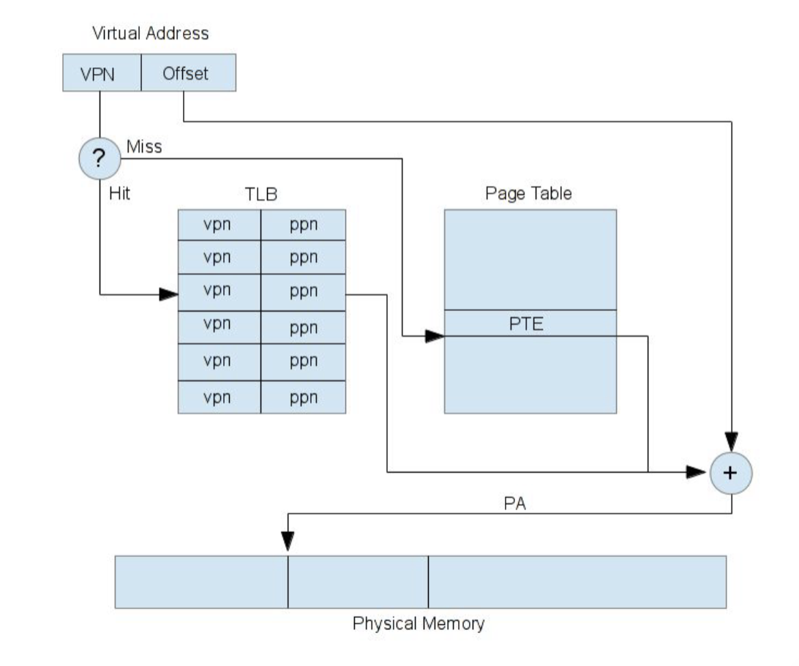
Address Translation with TLB
Check if there is a valid translation in the TLB
If there is a hit, we get the PFN without needing to access memory (yay)
If it is a miss, it will access the page table in memory to get the PFN mapping

Slide 36
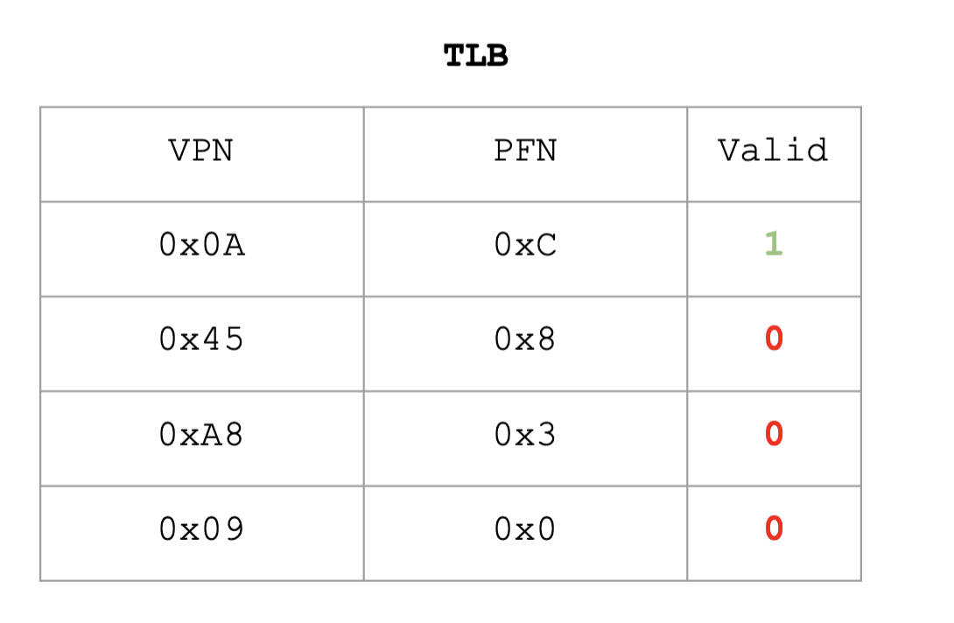
Exercise:
Memory access (8 bits for off):
Virtual Address: 0x04AC

Slide 37

Solution:
Virtual Address: 0x04AC
Miss → Need to access
the page table

Slide 38
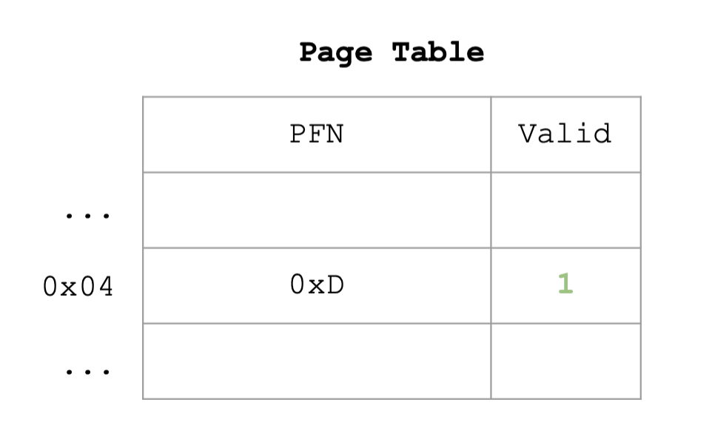
Solution
Get the PFN from the table and replace the TLB with the new mapping

Slide 39
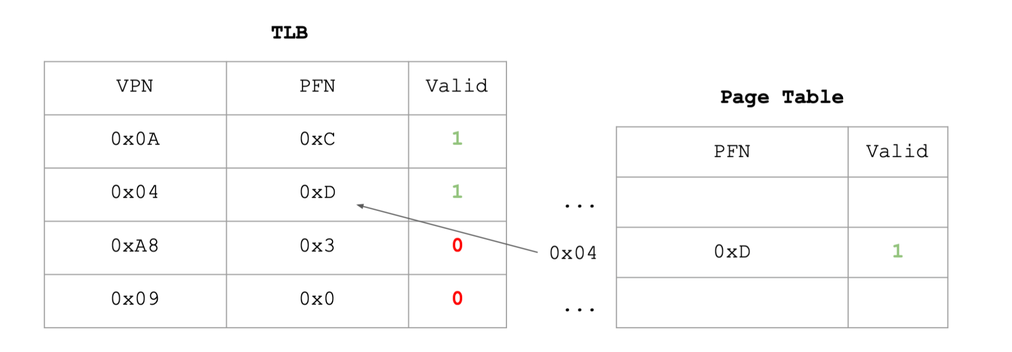
Solution
Updated the TLB mapping and changed the valid bit. For memory access 0x04AC, it will now be a hit and will now only require one access to memory (the load)

Slide 40
Thanks for Attending :)

